Slide 1
CORE TOPICS

Slide 2






FRAGMENT
LISTVIEW
ADAPTER DEMO

Slide 3
FRAGMENT
What is fragment? First, let's check the dictionary to see exactly what this word means:
Fragment | noun | /’frag-mənt/ Mảnh vỡ, mẩu, bộ phận của một vật gì đó
Fragment is an Android Component, is part of the user interface or behavior of an application .. As the name implies, fragment is not independent (độc lập), tied to a single Activity. They have many of the same functions as Activities.

Slide 4
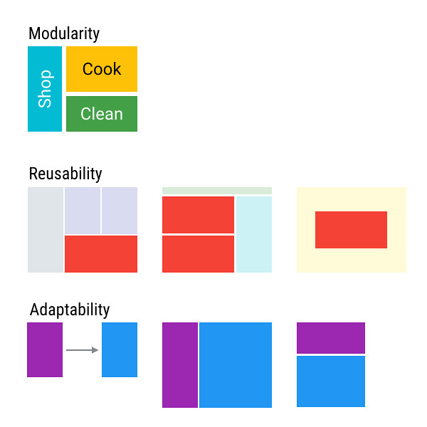
FRAGMENT

Slide 5
FRAGMENT
Modularity: For complex activities, the code will be implemented in fragments. Each fragment is an independent module. This will make the code easier to organize and maintain.
Reusability: Write code implementing interactions with users or UI parts into fragments so that they can be shared with other Activities.
Adaptability: Fragment provides a suitable and optimal way of presenting the user interface (UI) for Android devices of different screen sizes and pixel densities.

Slide 6
FRAGMENT
Represents a behavior or a part of user interface in a FragmentActivity
Android introduced fragments in Android 3.0 (API level 11)
You can combine multiple fragments in a single activity to build a multi-pane UI and reuse a fragment in multiple activities
Can add and remove while activity running. Call as sub activity

Slide 7
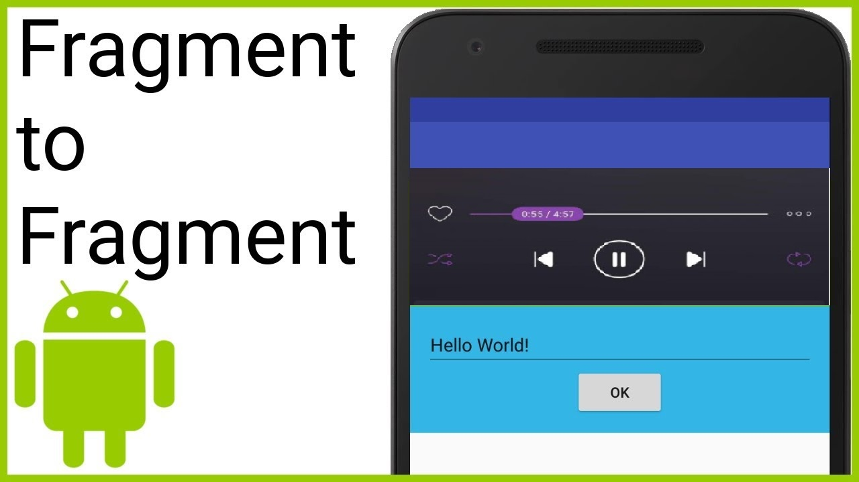
FRAGMENT
Example when you have music app with playlist. Playlist can have in every activity.
For example, when the activity is paused, so are all fragments in it, and when the activity is destroyed, so are all fragments.

Slide 8
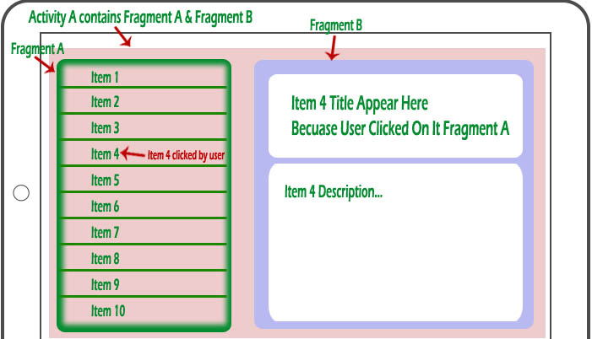
FRAGMENT
When you add a fragment as a part of your activity layout, it lives in a ViewGroup inside view layout.

Slide 9
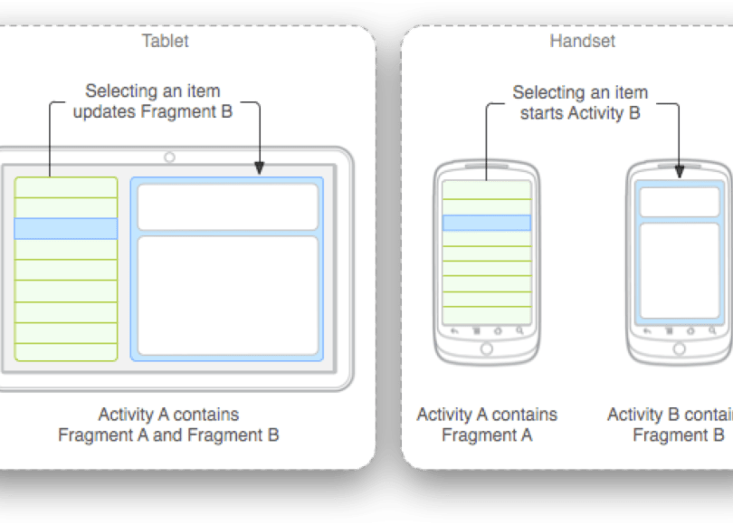
DESIGN
Think of how to modular and re-use
Add component for large screen and remove for small screen

Slide 10
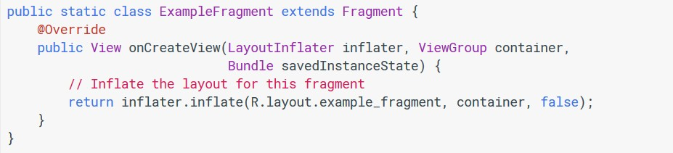
IMPLEMENT FRAGMENT
Step1: extend Fragment class and implement OnCreateView() method

Slide 11
IMPLEMENT FRAGMENT
Step2: add Fragment to Activity layout
<?xml version="1.0" encoding="utf-8"?>
<LinearLayout xmlns:android="http://schemas.android.com/apk/res/android"
android:orientation="horizontal" android:layout_width="match_parent" android:layout_height="match_parent">
<fragment android:name="com.example.news.ExampleFragment" android:id="@+id/list"
android:layout_weight="1" android:layout_width="0dp" android:layout_height="match_parent" />
</LinearLayout>

Slide 12
IMPLEMENT FRAGMENT
Replace / add / remove fragment when activity running
FragmentManager fragmentManager = getSupportFragmentManager(); FragmentTransaction fragmentTransaction = fragmentManager.beginTransaction();
ExampleFragment fragment = new ExampleFragment(); fragmentTransaction.add(R.id.fragment_container, fragment); fragmentTransaction.commit();

Slide 13
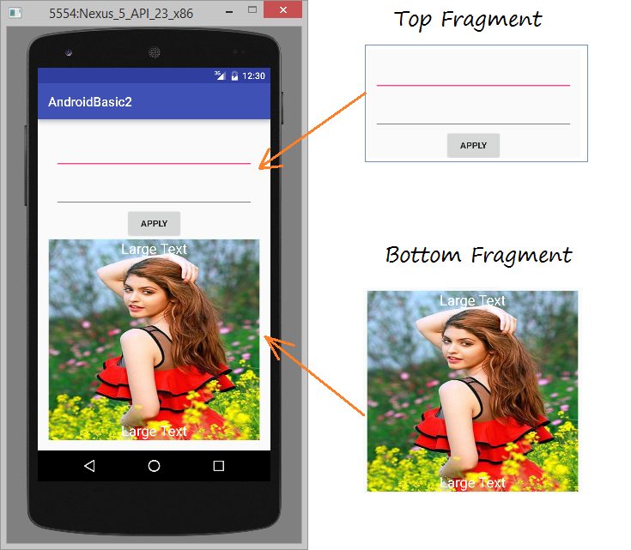
IMPLEMENT FRAGMENT

Slide 14
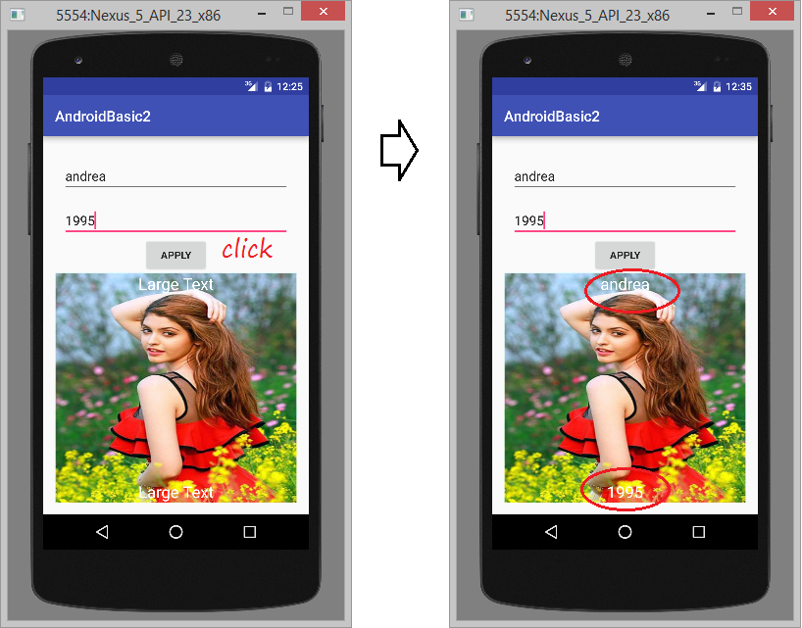
IMPLEMENT FRAGMENT

Slide 15
IMPLEMENT FRAGMENT
Sending data between Fragments
To send data between fragments, we use Bundle.
View example:
MyFragment myFragment = new MyFragment();
Bundle bundle = new Bundle();
bundle.putString("url","https://xuxu_minhanh");
myFragment.setArguments(bundle);

Slide 16
IMPLEMENT FRAGMENT
In file MyFagment.java,
In function onActivityCreated()
@Override
public void onActivityCreated(Bundle savedInstanceState) { super.onActivityCreated(savedInstanceState);
Bundle bundle = getArguments();
if (bundle != null) {
String link = bundle.getString("url"); setText(link);
}
}

Slide 17
FRAGMENT
LISTVIEW
ADAPTER DEMO

Slide 18
LISTVIEW
Android ListView is a view which groups several items and display them in vertical scrollable list.
The list items are automatically inserted to the list using an Adapter that pulls content from a source such as an array or database.

Slide 19
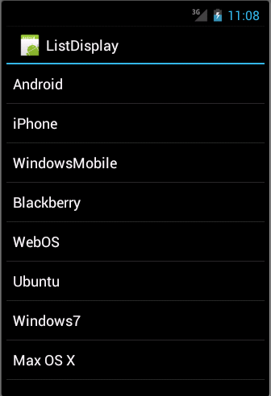
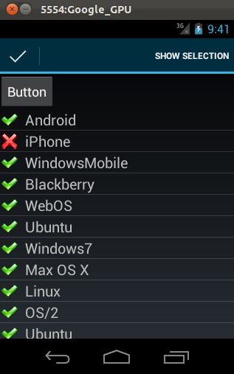
LISTVIEW

Slide 20
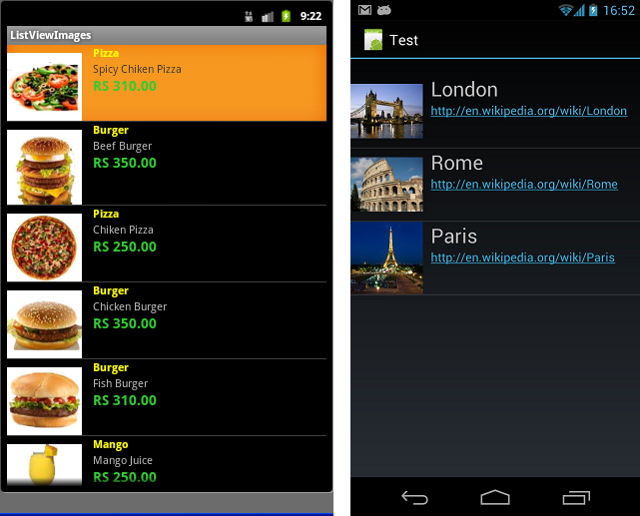
LISTVIEW

Slide 21
ADAPTER
An adapter is a bridge between UI components and the data source that fill data into UI Component
The list items are automatically inserted to the list using an Adapter that pulls content from a source such as an array or database.
Adapter holds the data and send the data to view
View can takes the data from adapter view and shows the data on different views like as spinner, list view, grid view etc

Slide 22
ADAPTER
ArrayAdapter
Base Adapter
CursorAdapter
SimpleCursorAdapter
WrapperListAdapter

Slide 23
IMPLEMENT LISTVIEW
Declare ListView in layout with id
Create layout for ListView
Select suitable adapter
Prepare data for adapter
Connect listview and adapter

Slide 24
ARRAY ADAPTER DETAILS
A ListAdapter can manage a ListView containing a list of elements of any type.
Very simple, you just need to "link" the data to the TextView through its ID with each line in the ListView as a TextView
For example, ListView includes a list of student names. If you want each ListView line to be more complex, which includes more elements (widget or component) I will guide you below.

Slide 25
ARRAY ADAPTER DETAILS
How to using an ArrayAdapter:
ArrayAdapter(Context context, int resource, int textViewResourceId, T[] objects)
context:
The first parameter is context using inference to current class. Usually using this Ngoài ra, chúng ta cũng có thể sử dụng getApplicationContext(), getActivity() to replace keyword this. getApplicationContext() using in Activity, getActivity() using in Fragment.

Slide 26
ARRAY ADAPTER DETAILS
How to using an ArrayAdapter:
ArrayAdapter(Context context, int resource, int textViewResourceId, T[] objects)
resource:
Second parameter is (resource) using id to set list in Layout. In Layout such as: TextView, ImageView, Button .v.v
The following example we create a named Layout:
custom_list_items.xml

Slide 27
ARRAY ADAPTER DETAILS
custom_list_items.xml
<?xml version="1.0" encoding="utf-8’’ ?>
<RelativeLayout xmlns:android="http://schemas.android.com/apk/res/android" android:layout_width="match_parent" android:layout_height="wrap_content">
<TextView android:id="@+id/textView" android:layout_width="wrap_content" android:layout_height="wrap_content" android:padding="@dimen/activity_horizontal_margin" android:text="Demo" android:textColor="#000" />
</RelativeLayout>

Slide 28
ARRAY ADAPTER DETAILS
How to using an ArrayAdapter:
ArrayAdapter(Context context, int resource, int textViewResourceId, T[] objects)
Object:
The fourth parameter is the object data type, we can get and set data through this parameter.
String animalList[] = {"Lion","Tiger","Monkey","Elephant","Dog","Cat","Camel"};
ArrayAdapter arrayAdapter = new ArrayAdapter(this, R.layout.list_view_items, R.id.textView, animalList);

Slide 29
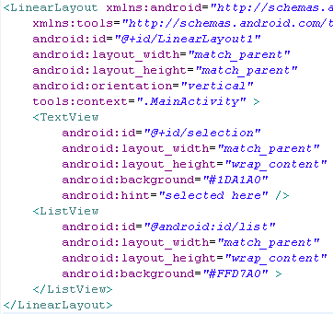
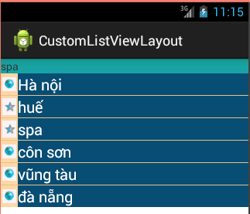
IMPLEMENT LISTVIEW
Custom layout

Slide 30
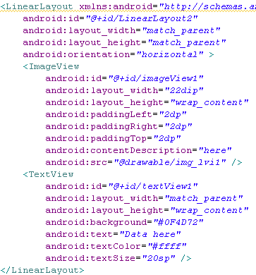
IMPLEMENT LISTVIEW
Custom layout

Slide 31
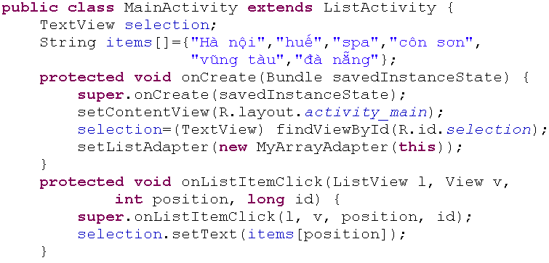
IMPLEMENT LISTVIEW
Custom layout

Slide 32
QUESTION
&
THANK YOU FOR YOUR ATTENTION

